Slide 1

Sleep Patterns of Students in Undergrad
Jasmine Roberts
CTEC128-102-Fall2024
December 3, 2024

Slide 2

Problem Statement
The main problem is :
The lack of sleep duration
Insomnia
The lack of good sleep quality
Daily activities affecting sleep duration
Why do we tend to not sleep well during the weekday?
Why do we tend to sleep better during the weekend?
Overall, what age group has the most insomnia?

Slide 3

Research Questions
Which age group developed insomnia the most?
Which age group received the recommended amount of sleep?
What is the total sleep duration of each student?

Slide 4

Columns of the Datasets
Columns that will be in consideration:
Age
University Year
Caffeine Intake
Screen Time
Weekday Sleep Start/End
Weekend Sleep Start/End
Study Hours
Physical Activity
Columns that will not be used:
Student ID
Gender
For personal and privacy reasons of the student.
501 students in total

Slide 5

Vizualizations and Specific Tasks
The following charts were used:
Histograms
Column Charts
Bar Charts
Line Charts
Pie Charts
The specific tasks are as followed:
Comparing data
Anazlyzing the data for similarties
Anazlyzing the data for differences
Analyzing if theres any correlation(s) with sleep patterns among age
Analyzing if there any correlation(s) with the sleep patterns among caffeine instake
Calcuate the total number of sleep duration for each student

Slide 6

Summary Findings

Slide 7
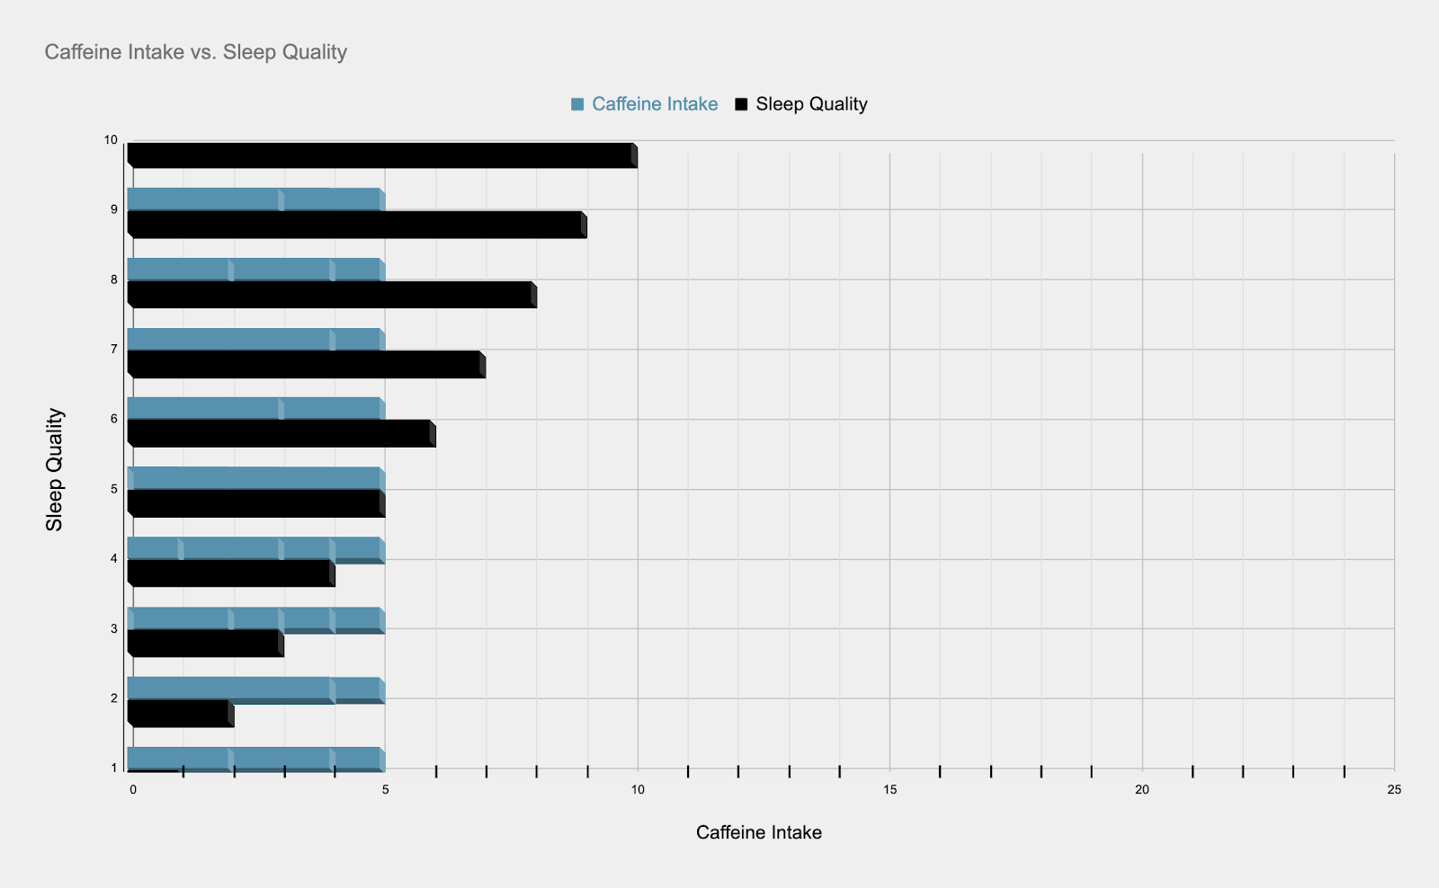
This chart was made from the data set columns ”Caffeine Intake” and “Sleep Quality”
The more caffeine you drink the worse your sleep quality is going to be
The less caffeine you drink the better your sleep quality is going to be
Students who had 2 out of 10 quality of sleep and 5 out of 10 caffeine or higher intake had the worst sleep
Students who had a 10 out of 10 sleep and 5 out of 10 caffeine intake or lower had the best sleep
Overall, majority had a high caffeine intake each day, which affected their sleep quality

Slide 8
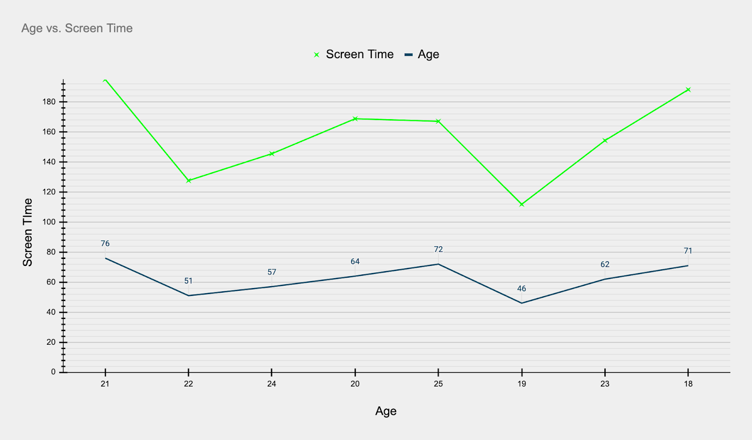
This chart was made from the data set columns ”Screentime” and “Age”
Age plays a big role in screentime
The younger you are the more screen time you are going to have
The more screentime, the more you are going to stay up longer
The less screentime, the more sleep you are going to get
The average screentime is 188.3hrs
18 and 21 years olds have the most screentime
19, 20, 22,23,24,25 year olds have the least screentime

Slide 9
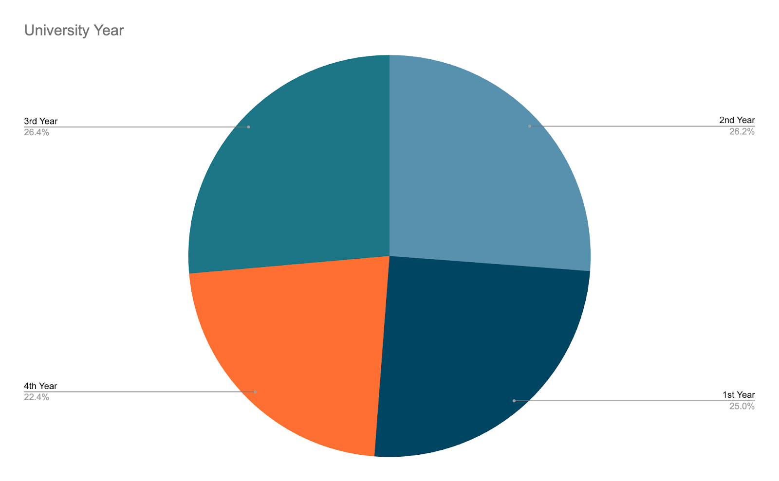
This chart was made from the dataset column ” University Year”
Most of the students in undergrad are Juniors
Mostly Juniors have more stress/insomnia because reality sets in

Slide 10
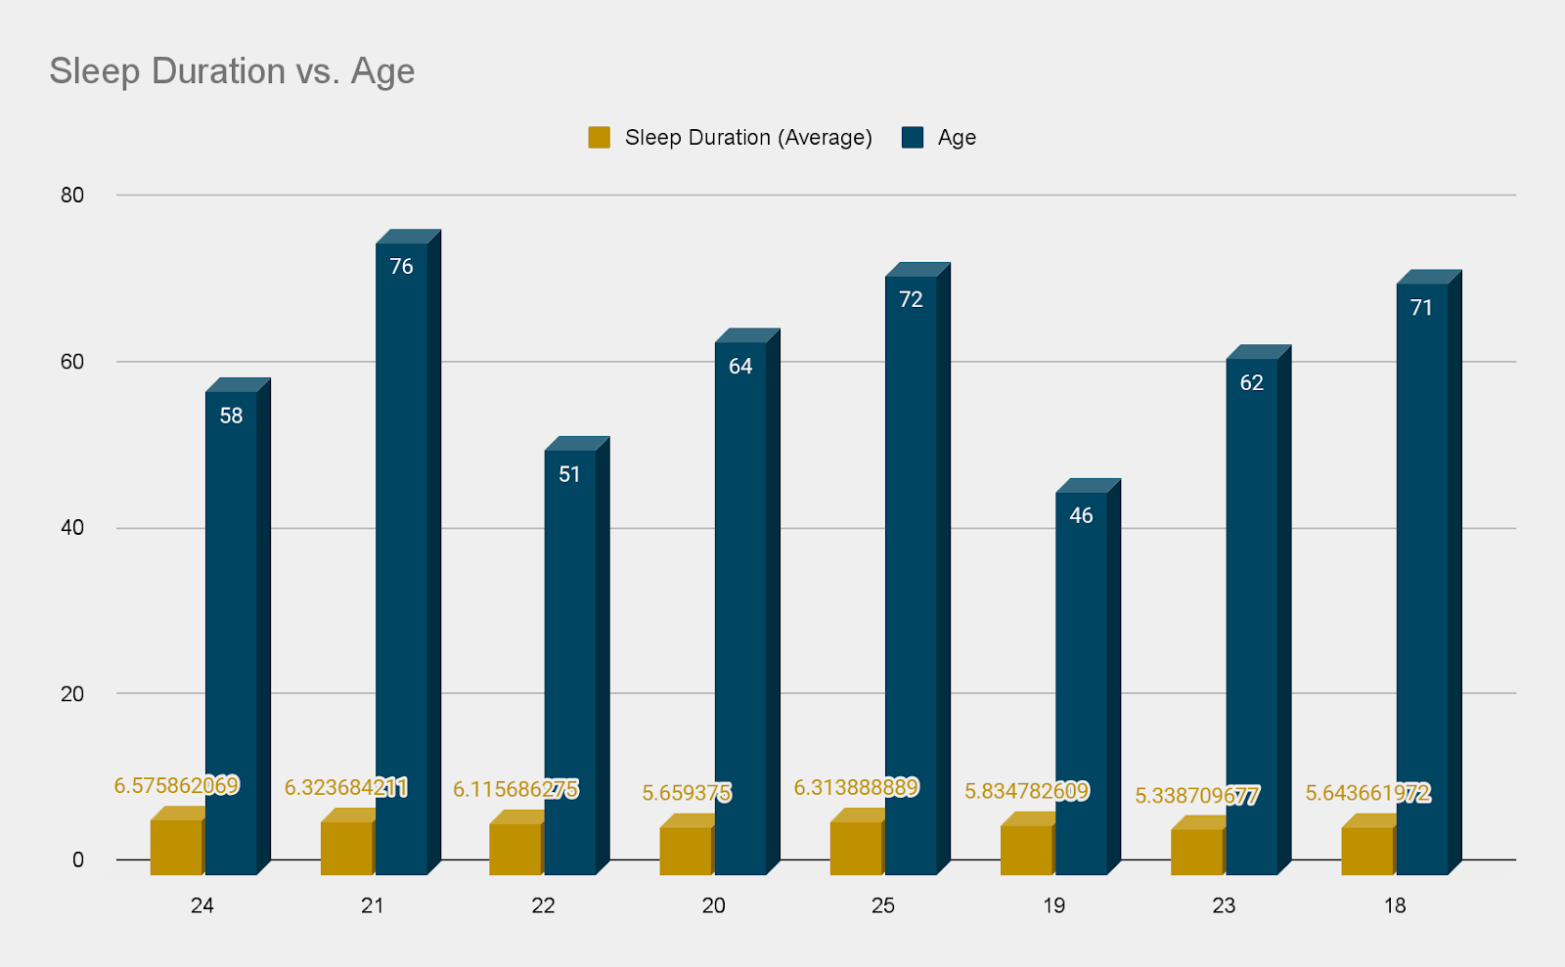
This chart was made form the datasheet columns “Sleep Duration” and “Age”
Sleep Duration times are averaged out (gold)
24 years olds had the longest sleep duration (8 hours plus)
Age are counted (blue)
18,19,20,21,22,23 and 25 year olds have the worst insomnia

Slide 11
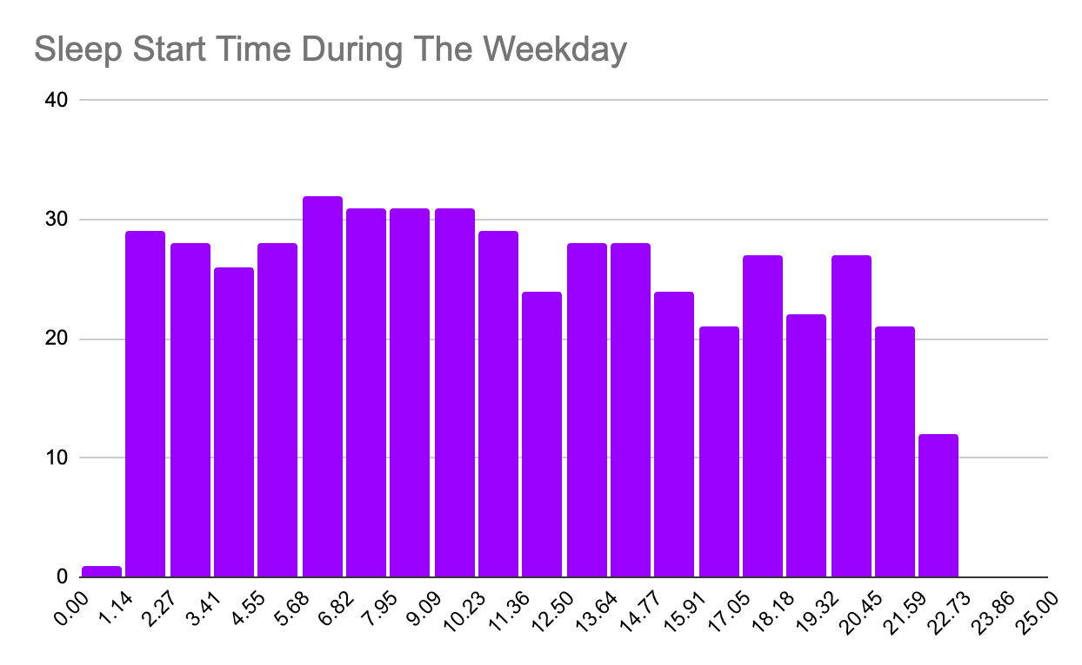
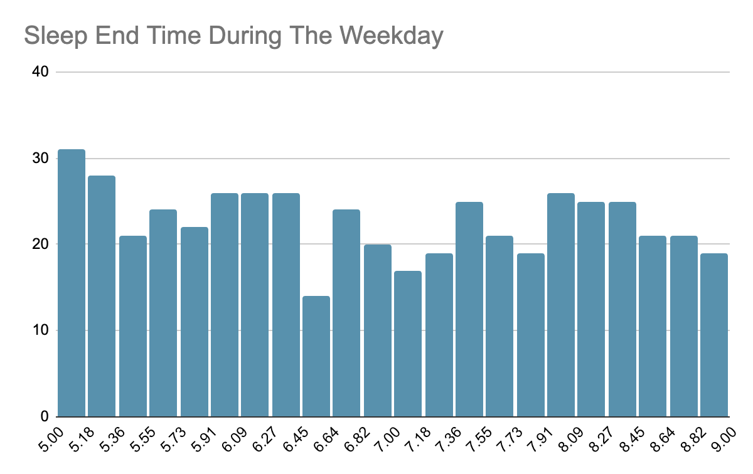
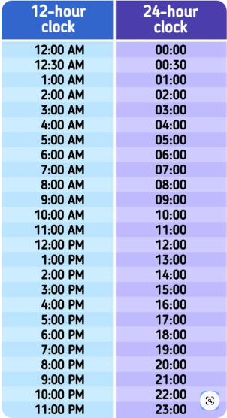
This chart was made from the datasheet columns “Sleep Start Time During the Weekday” and “Sleep End Time During The Weekday”
Sleep Times are in military time
Sleep Start Times are on the x-axis
The charts display the count of how many student fell asleep around those times are on the y-axis during the weekday
On average, majority went to sleep around 1-2am and 5am on the weekdays, and woke up around 10am

Slide 12
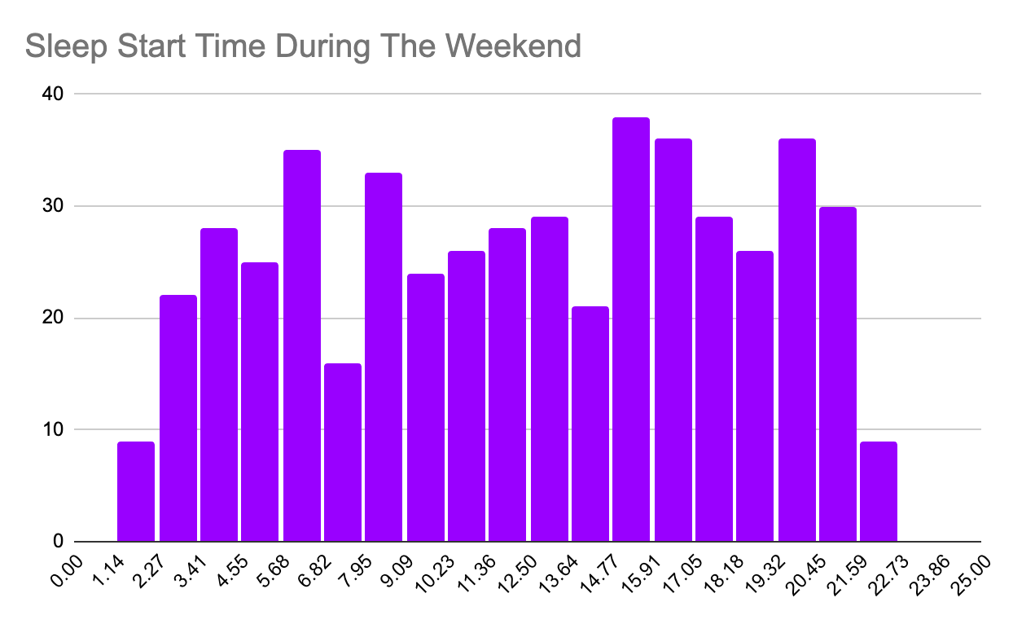
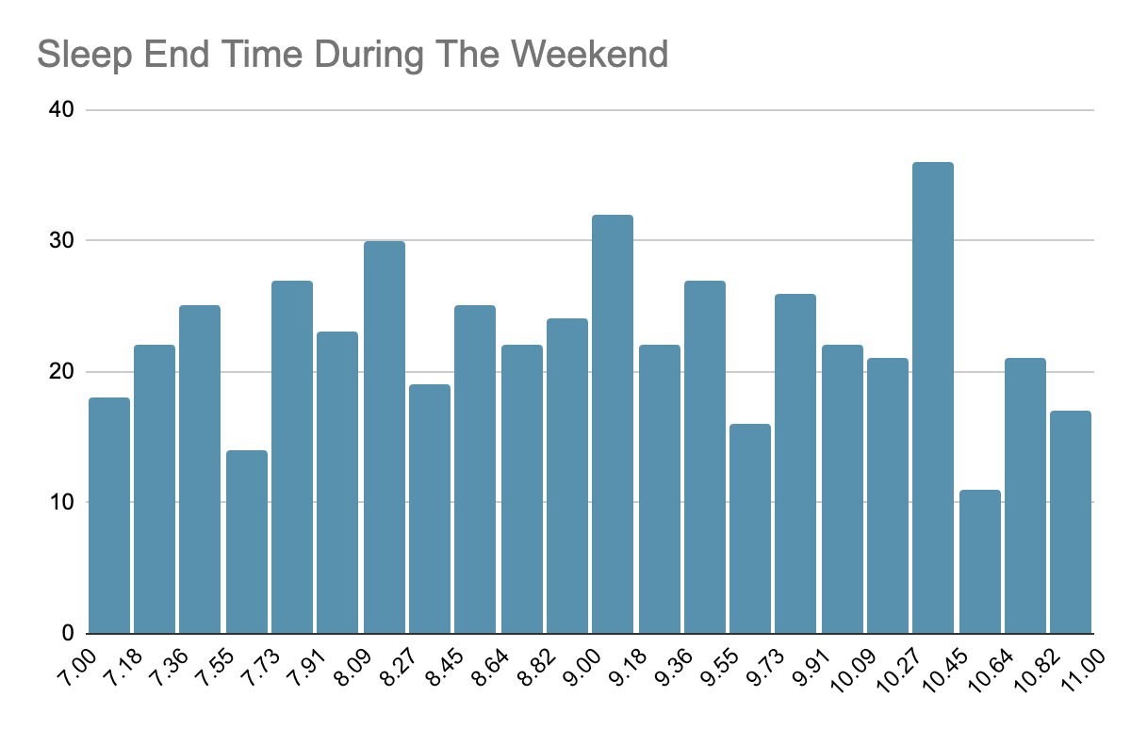
This chart was made from the datasheet columns “Sleep Start Time During the Weekend” and “Sleep End Time During The Weekend”
Sleep Times are in military time
Sleep Start Times are on the x-axis
The charts display the count of how many student fell asleep around those times are on the y-axis during the weekend
On average, majority went to sleep around 3-5am on the weekends, and woke up around 3-4pm

Slide 13
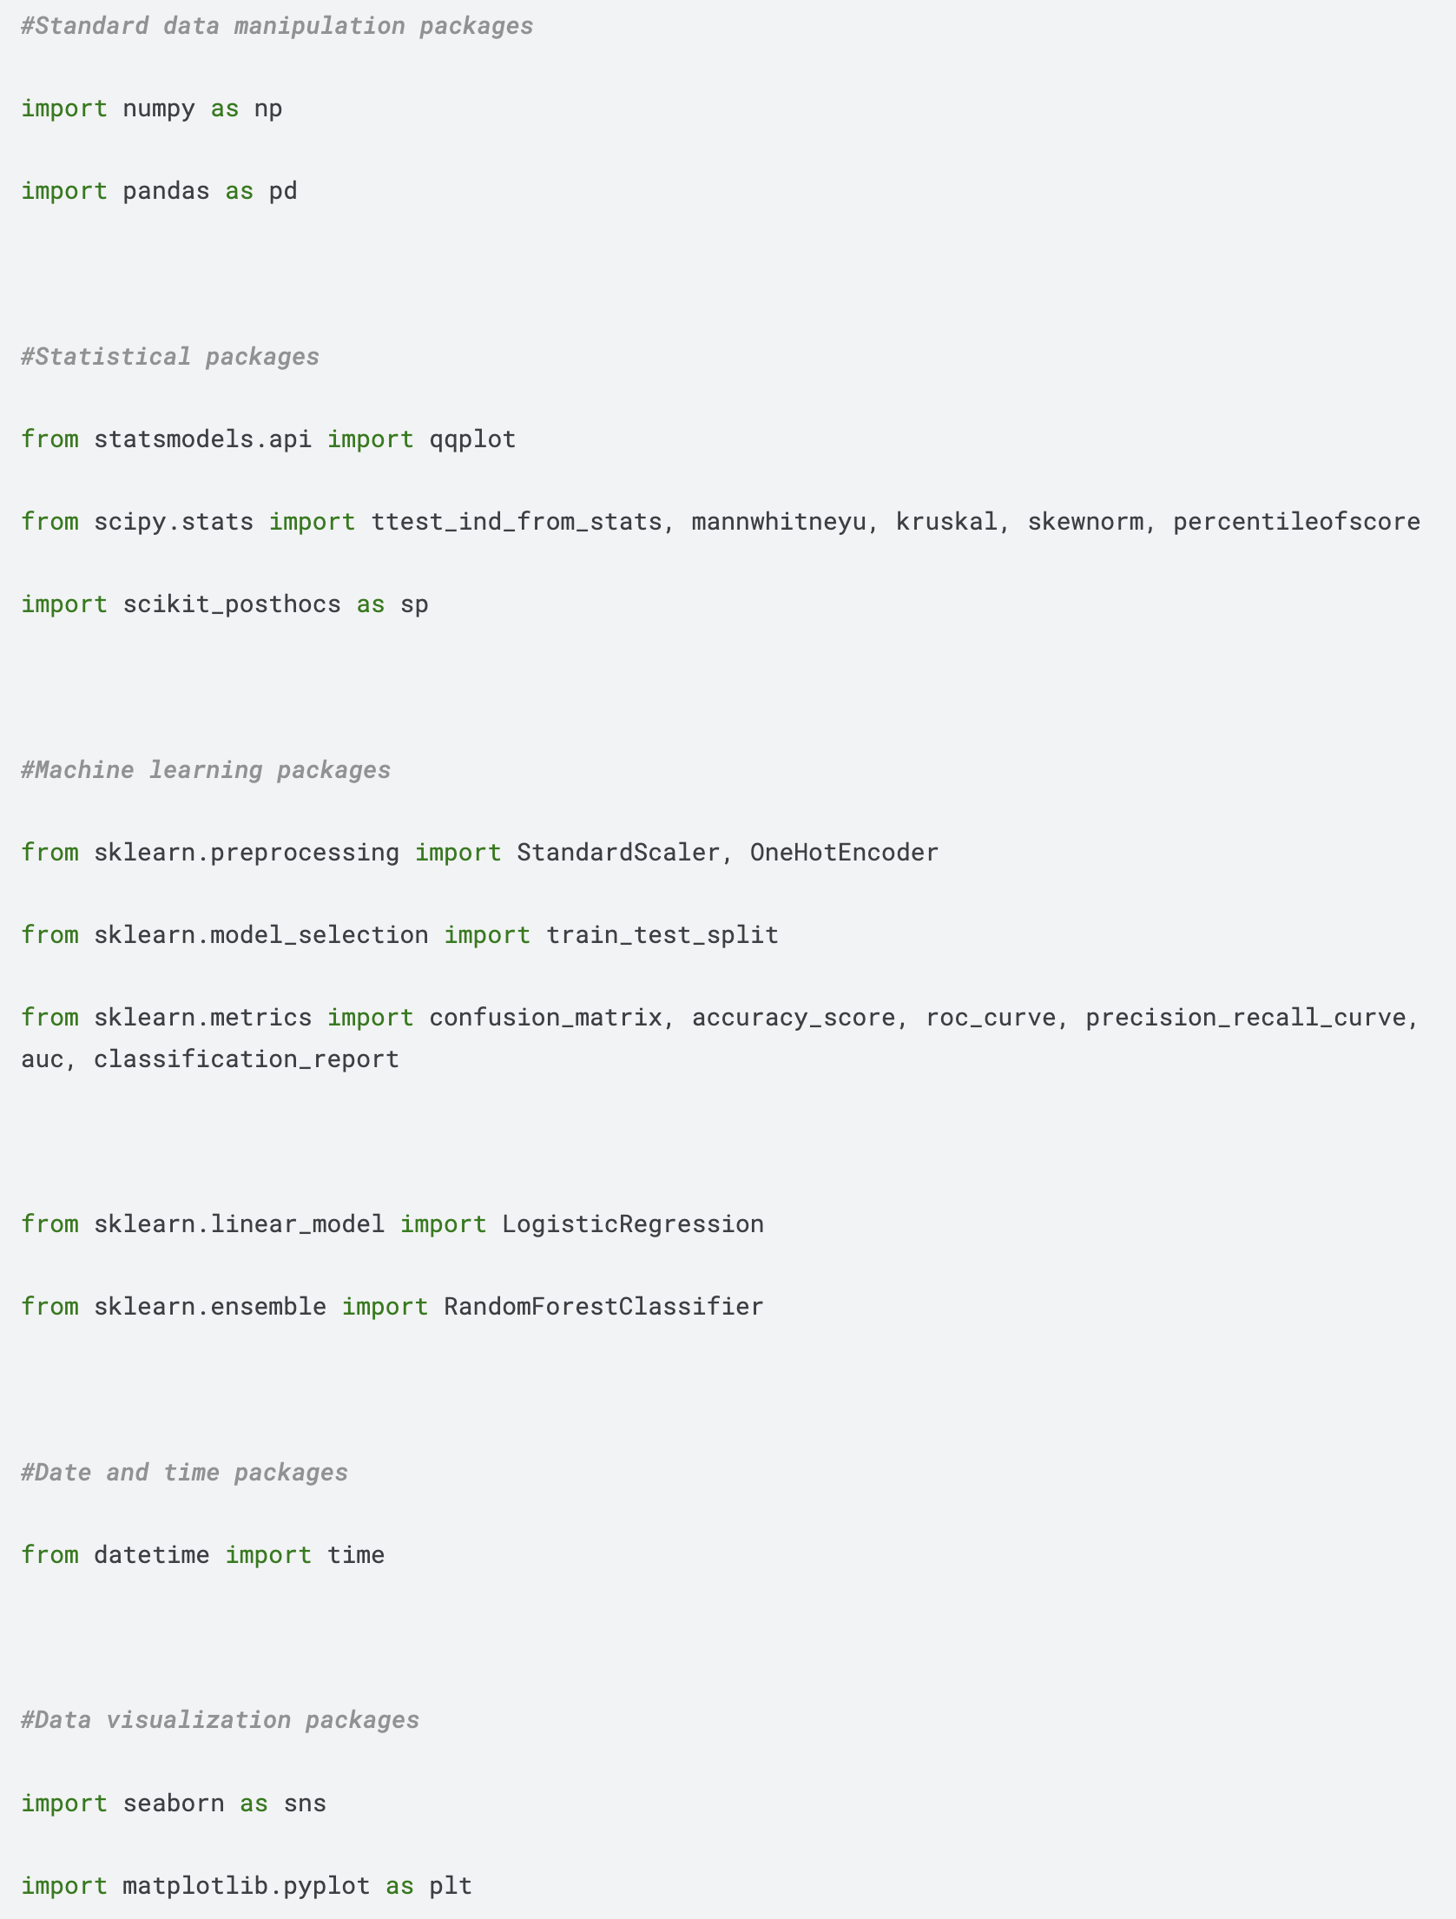
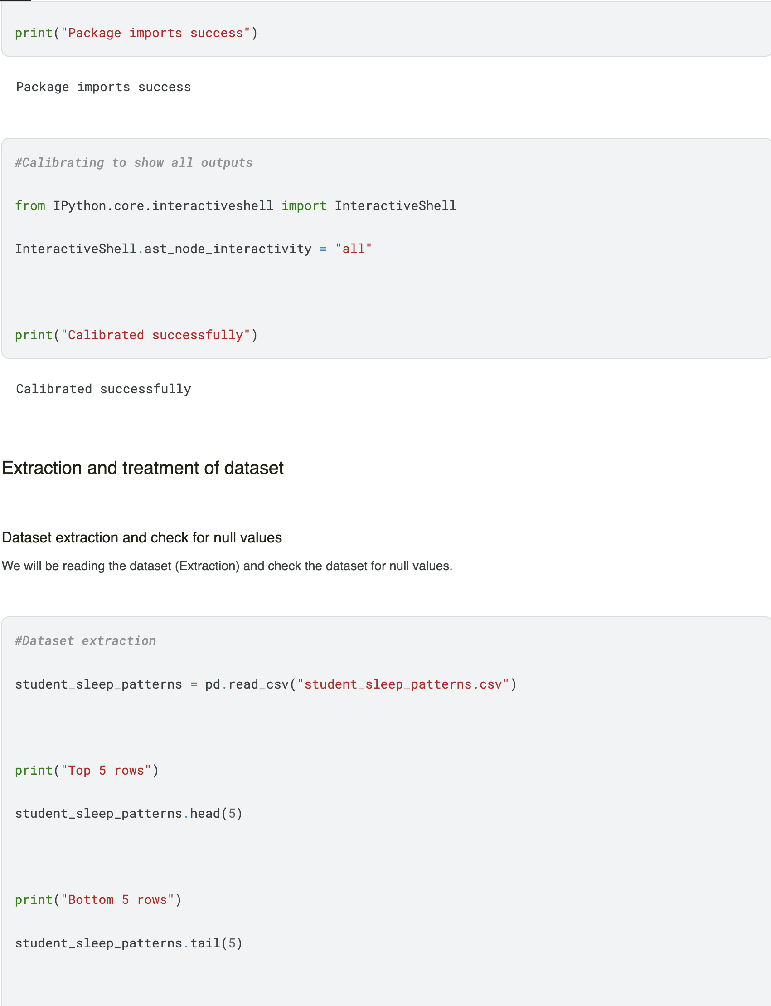
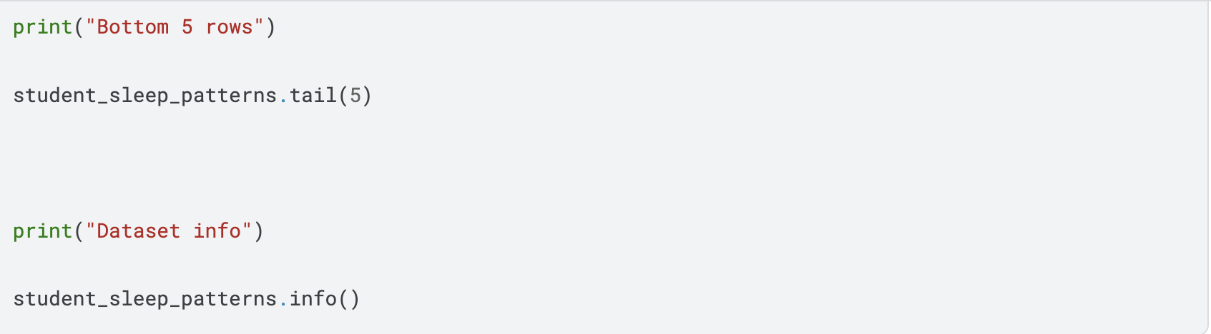
Data Cleanup Code

Slide 14
Conculsions
My findings are important because:
it is based on real life and can happen in real life
displays what college students in undergrad goes through as far as their sleep health
This project was more in-depth of how much students can lack sleep based on various activites
In the future this can be used as a case study and/or another statistic project with a similar or different goal
24 years olds had the longest sleep duration (8 hours plus)
18,19,20,21,22,23 and 25 year olds have the worst insomnia

Slide 15
THE END

